Slide 1
Sub-Program Converter
User Manual Rev. B
v1.0

Slide 2
overview

Slide 3
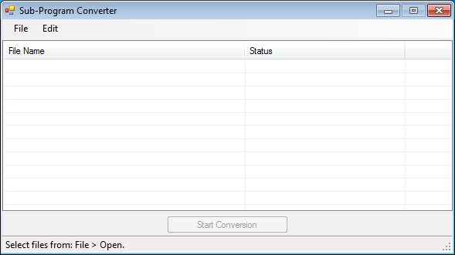
Menu Bar
Open target files or manipulate them after loaded
from here.
File List
Showing status of each loaded file.
Start Button
Status Bar
Some hint on current status of the convertor.

Slide 4
HOW TO USE IT?

Slide 5
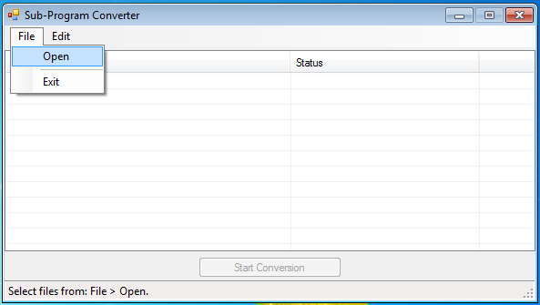
Step 1
Click “File” from the menu bar, and then select “Open”.

Slide 6
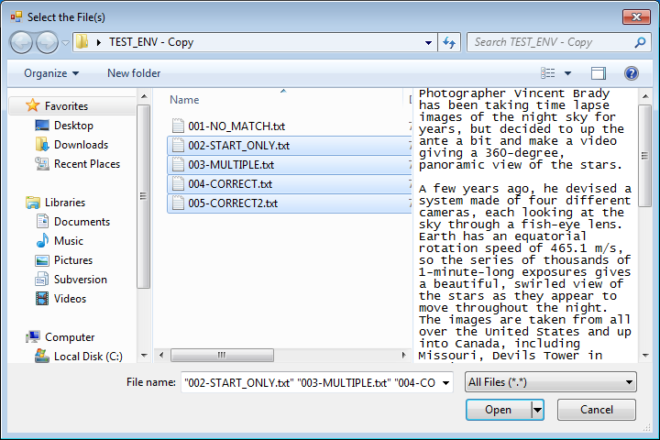
Step 2
Choose the files as needed, multi-selection is acceptable.

Slide 7
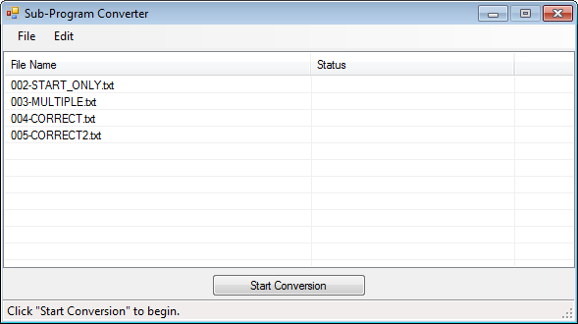
Step 3
After files load in to the converter, the button below will be enabled.
Skip to Step 6 to proceed the conversion.

Slide 8
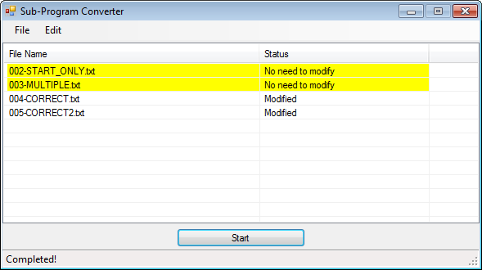
Step 4 – Viola :)
Click the button shall initiate the conversion. Results will show on the right side.
File not processed will mark as yellow. (See the graph above)

Slide 9
Edit operations

Slide 10
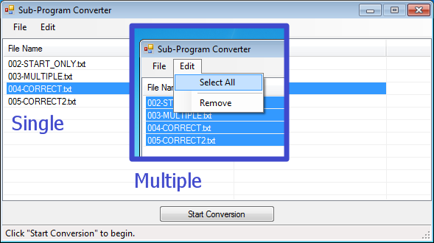
Selections
To delete any item, use “Edit” > “Select All”, to select every item, or select them individually.

Slide 11
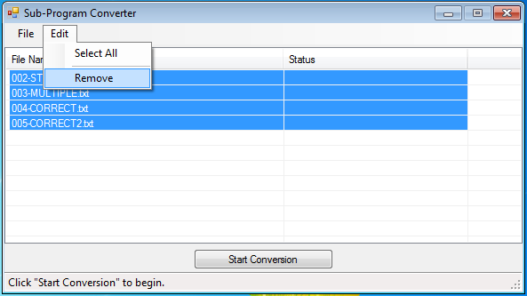
Remove
Click “Remove” to remove selected items.
Note: There’s NO undo option here.

Slide 12
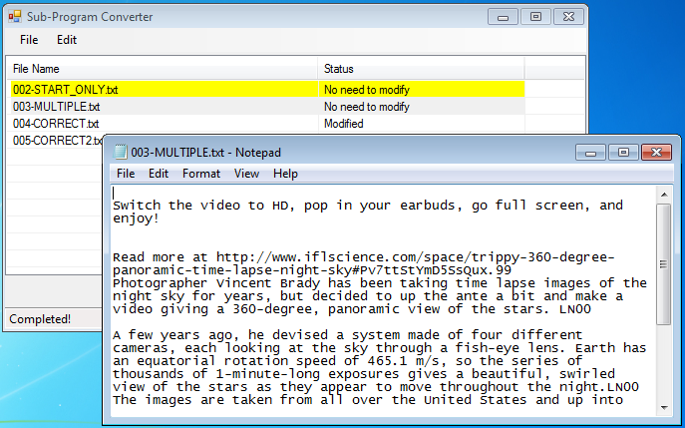
Double-Click Edit
Double-click the item to edit it, converter will open the file editor associates in the system.

